Slide 1
Data Exploration of the 2005-2006 School Survey on Crime and Safety
Claire Zhang & Jim Wright
EDLD 610
Fall 2019

Slide 2
Journey
Jim
Hesitant towards taking this class at first
Very pleased with my progress using R after the past 10 weeks
Still a lot to learn and foundation to strengthen
Claire
Hard decision at the end of week 1
So lucky to find a partner who becomes my biggest motivation
Time investment is necessary
Study plan for winter break
Notes:
Jim Notes:
Grateful my advisor encouraged taking it
Feel like I have a much better understanding of R compared to when I was first exposed to it in my Multiple Regression course fall 2018
Didn’t plan on continuing the course sequence but now I plan to

Slide 3
Data
2005-2006 School Safety Survey completed by school principals
SPSS data file accessed from data.gov
Survey sent to stratified random sample 3,565 U.S. public schools
2,724 survey respondents
R => 525 columns by 2,724 rows

Slide 4
Variables of Interest
14 Total variables (including “school_id”)
4 Categorical variables
5 Logical variables
4 Quantitative variables

Slide 5
Categorical Variables
Urbanicity
City
Urban fringe
Town
Rural
Level
Primary
Middle
High school
Combined (both Middle and High school)
Minority Percentage
Less than 5 percent
5 to 20 percent
20 to 50 percent
50 percent or more
Enrollment
Less than 300
300 - 499
500 - 999
1,000 or more

Slide 6
Logical Variables
Yes/No survey response on provision of certain types of teacher training
Classroom Management
Discipline Policies
Safety Procedures
Early Warning Signs for Violent Behavior
Positive Behavioral Intervention

Slide 7
Quantitative Variables
Numerical totals of the following variables:
Disciplinary Actions Recorded
Incidents Recorded
Incidents Recorded to Police
Out of School Suspensions

Slide 8
Challenges
Jim
Identifying when to use and how to successfully use pivot_longer() and pivot_wider()
Adjusting ggplot features (e.g. scale, legend title, ect)
Applying what I learn/observe in class to what I want to with my data
Notes:
Jim Notes:
At times I felt like I followed along well with what was being done in class but then felt like a deer in headlights when it came time for me to do it on my own

Slide 9
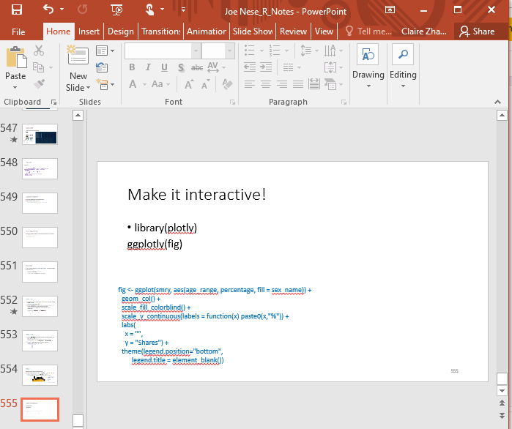
Challenges
Claire
Didn’t have time to familiarize myself with R language
Use Joe’s slides and Google everytime writing code
Lab 10 :......(
How to use knowledge learned to do data analysis
Notes:
Jim Notes:
At times I felt like I followed along well with what was being done in class but then felt like a deer in headlights when it came time for me to do it on my own

Slide 10
Successes
Jim
Better understanding of the following functions: mutate(), rename(), summarize(), and group_by()
Use and interpretation of linear models
Claire
Successfully figured out most of the labs!
Better understanding of some functions: filter(), select(), mutate(), summarize(), group_by(), and pivot_longer()
Enjoy data visualization: graphs and plots are awesome in presentation!
Notes:
Jim Notes:
Functions I gained more confidence and understanding after working on this project: mutate(), rename(), pipe, summarize(), and group_by()

Slide 11
Ongoing Challenges
Jim
geom_bar() vs geom_col()
Strings and factors
Use of logical variables
Editing legend titles and plot features (e.g. remove “_” from legend title)
Notes:
Jim Notes:
I think I’m better understanding geom_bar() vs geom_col() but there were a few instances in our code where it seemed one worked better than the other - my success with geom_col is when I had a specific y variable to map to
My understanding of strings and factors is getting better, but it’s something I need to work on before next term
After completing the latest dataquest assignment, I thought it would be really cool to create logical variables based on status of teacher training and combine multiple trainings into single logical variables, but I wasn’t sure how to execute it

Slide 12
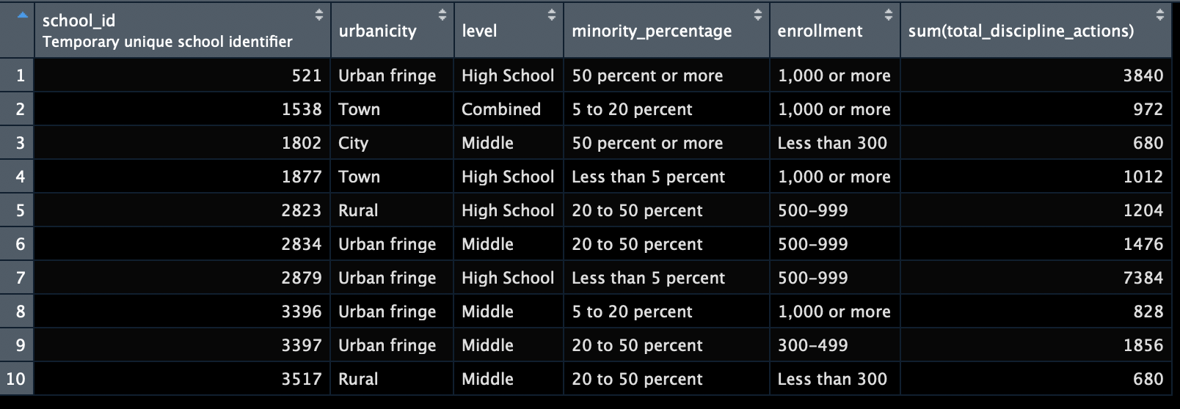
Results
Purpose of this table was to filter schools that had above average discipline actions and didn’t provide any teacher training
Notes:
We wanted to use the filter and mutate functions
Filtered schools with status “no” for all teacher trainings
Mutated all four quantitative variables for types of disciplinary actions into one category (total)
Determined average number (159) and filtered schools with above average total

Slide 13
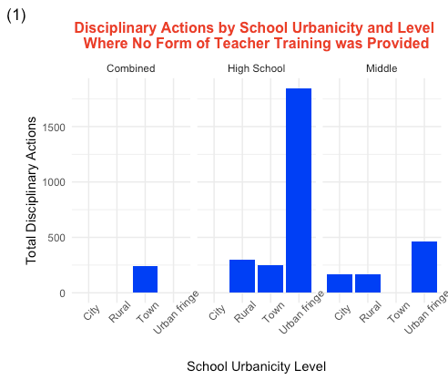
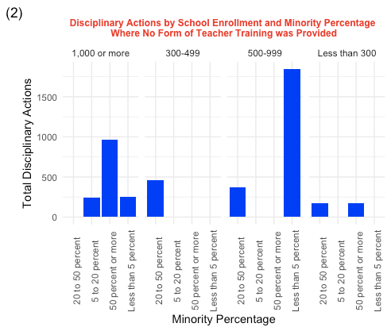
Results
Notes:
Plot one displays these schools using geom_bar
Both plots display total number of disciplinary actions on the y-axis.
Plot one displays school urbanicity level on the x-axis faceted by school level
Plot two displays minority percentage on the x-axis facted by school enrollment

Slide 14
Linear Models
mod1 <- lm(total_discipline_actions ~ urbanicity + enrollment, data = safe_organized)
mod2 <- lm(total_discipline_actions ~ urbanicity + enrollment + level, data = safe_organized)
mod3 <- lm(total_discipline_actions ~ urbanicity + enrollment + level + minority_percentage, data = safe_organized)
mod4 <- lm(total_discipline_actions ~ training, data = tt_oss)

Slide 15
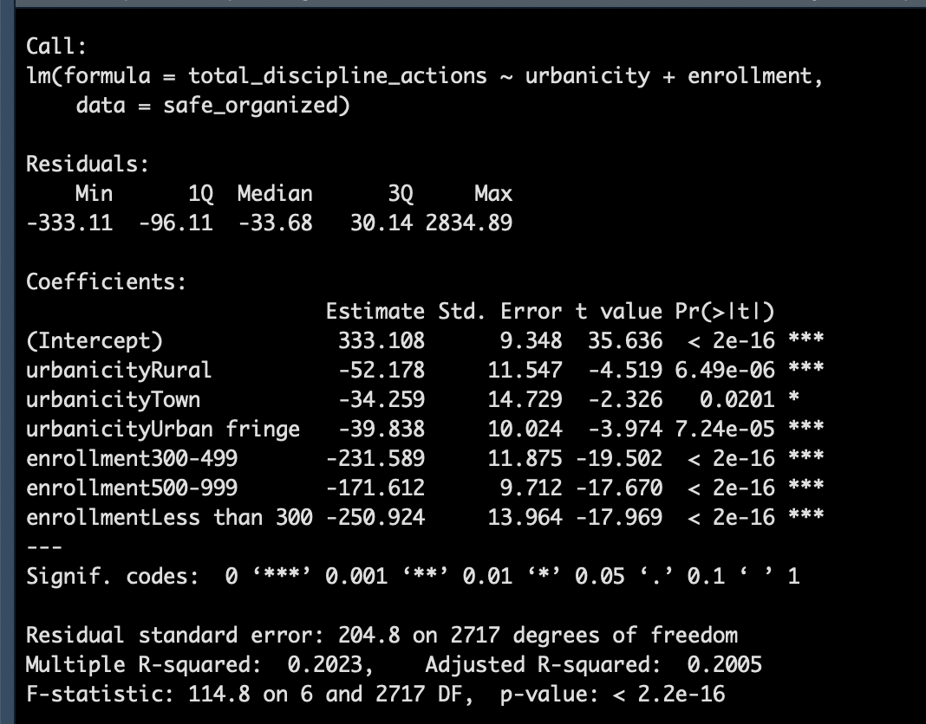
mod1 Summary
Accounted for 20.05% of the variance
Schools coded as City with an enrollment of 1,000 or more students reported an average of 333.11 total disciplinary actions
Notes:
Schools coded as City with an enrollment of 1,000 or more students reported an average of 333.11 total disciplinary actions. On average, schools coded as Rural reported 52.18 fewer disciplinary actions, schools coded as town reported 34.26 few disciplinary actions, and schools coded as Urban Fringe reported 39.84 fewer disciplinary actions.
On average, schools with an enrollment of 300-499 reported 231.59 fewer disciplinary actions. Schools with an enrollment of 500-999 reported 171.61 fewer disciplinary actions, and schools with an enrollment less than 300 reported 250.92 fewer disciplinary actions

Slide 16
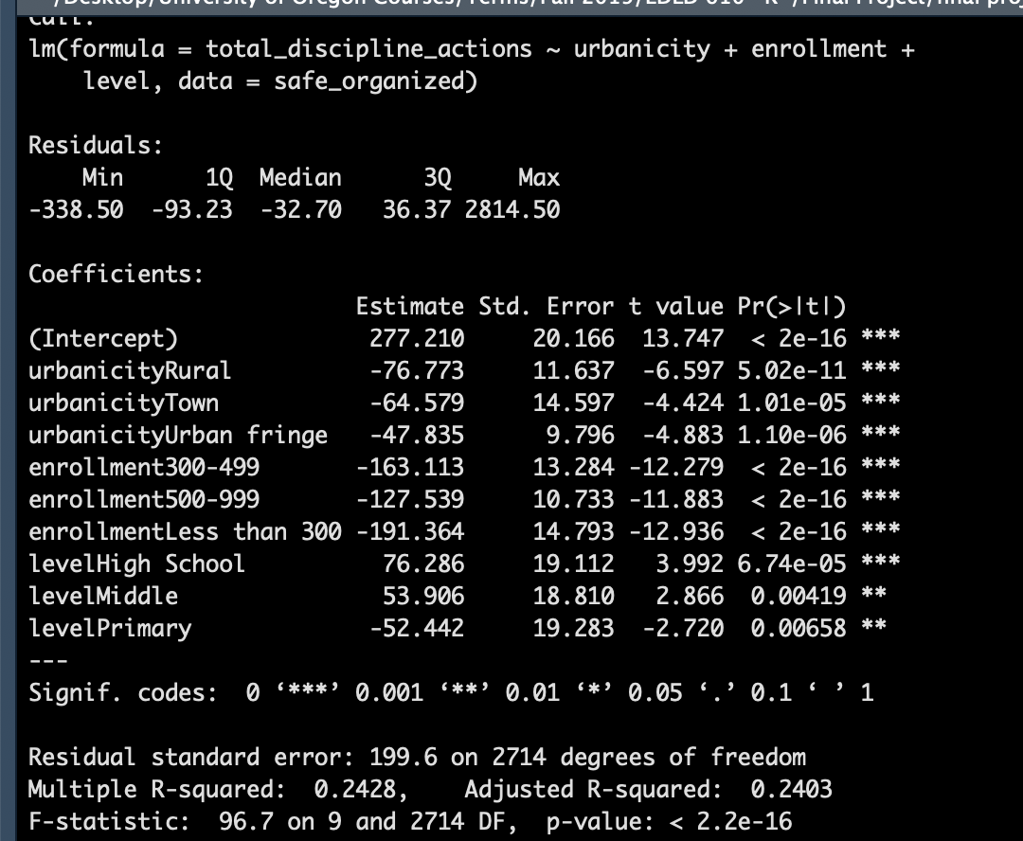
mod2 Summary
Accounted for 24.03% of the variance with the variable Level added to the model
Schools coded as City and Combined with an enrollment of 1,000 or more students reported on average 277.21 disciplinary actions
Findings are similar to model 1 for urbanicity and enrollment variables
Interesting change with Level added to the model
Notes:
Schools coded as high school reported on average 76.29 more disciplinary actions and schools coded as Middle reported on average 53.91 more disciplinary actions. Schools coded as primary reported on average 52.44 fewer disciplinary actions

Slide 17
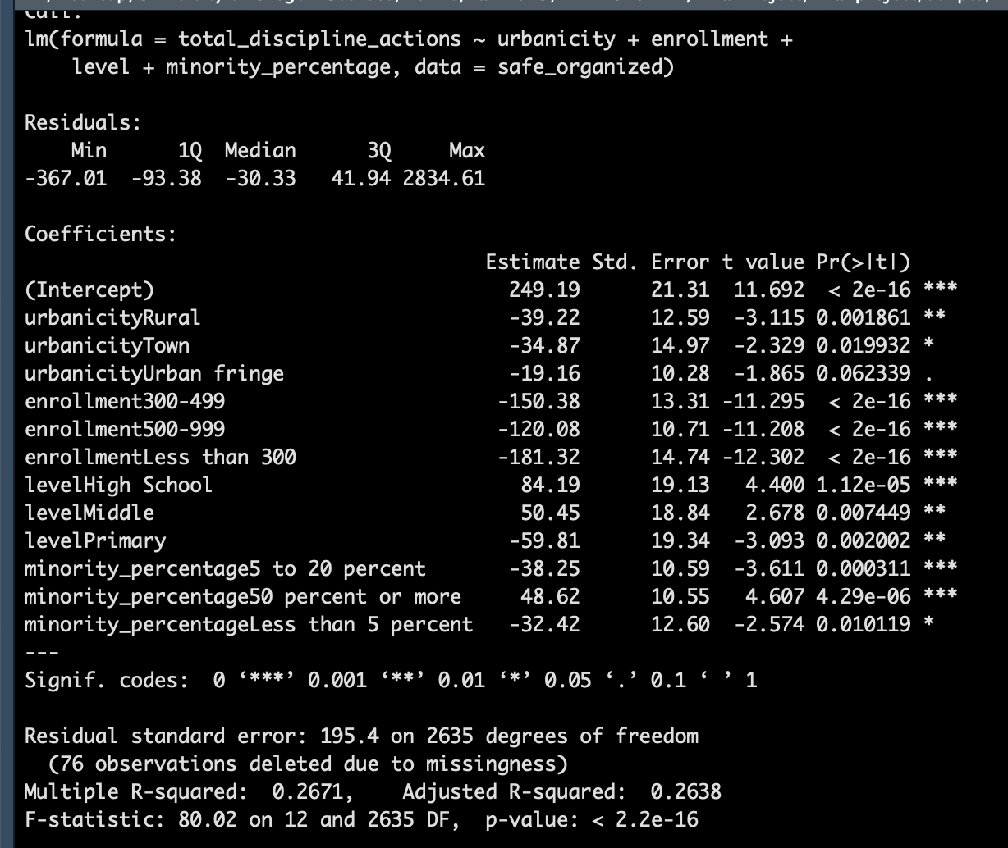
mod3 Summary
Accounted for 26.38% of the variance with the variable Level added to the model
Schools coded as City and Combined with an enrollment of 1,000 or more students and a Minority Percentage of 20-50% reported on average 249.19 disciplinary actions
Findings are similar to models 1 and 2 for urbanicity, enrollment, and level variables
Minority Percentage addition resulted in strongest model
Notes:
Schools with a minority percentage of 5-20% reported on average 38.25 fewer disciplinary actions. Schools with a minority percentage of 50% or more reported an average of 48.62 more disciplinary actions, and schools with a minority percentage of less than 5% reported an average of 32.42 fewer disciplinary actions

Slide 18
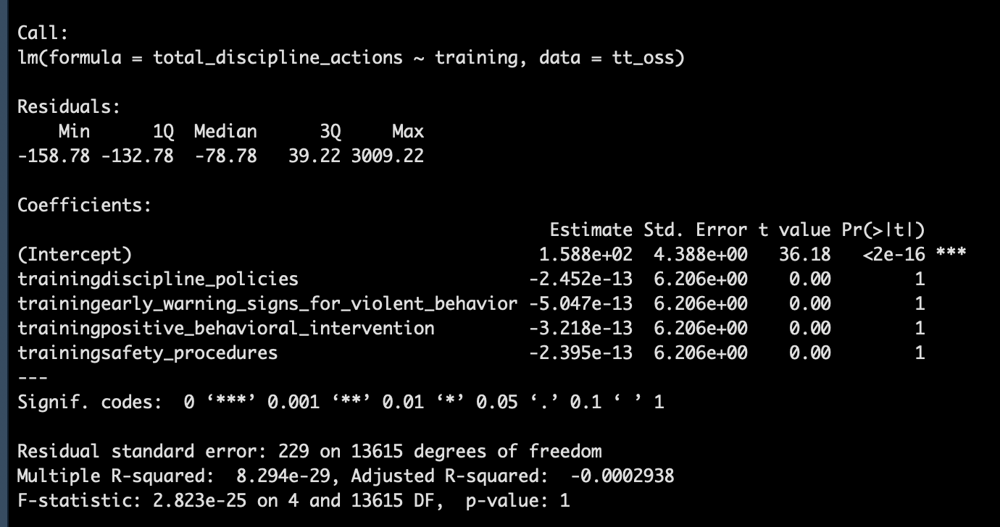
mod4 Summary
More difficult to interpret this model
Doesn’t appear to account for any variance within the model
The intercept represents teacher training for classroom management
All other forms of teacher training appear to, on average, align with fewer disciplinary actions

Slide 19
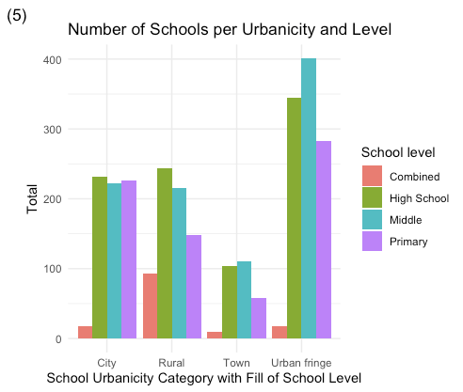
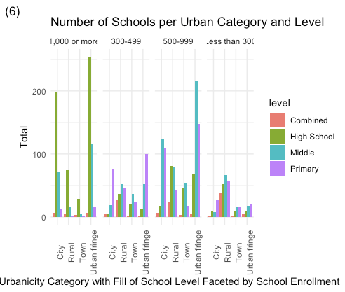
More Plots!
Notes:
Both plots present number of schools by urban category
Fill is school level in both with a facet of enrollment in the plot on the right

Slide 20
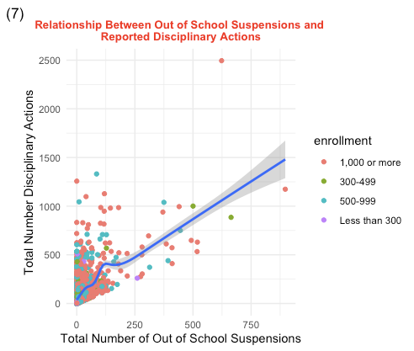
Notes:
Scatterplot of total number of out of school suspensions by total number of disciplinary actions filled by school enrollment

Slide 21
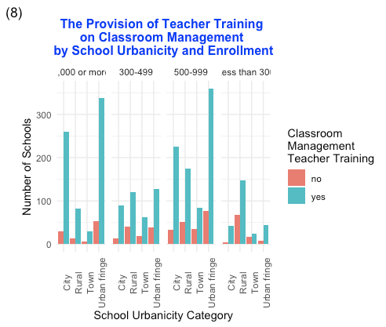
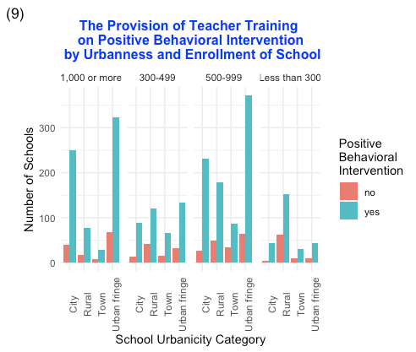
Notes:
Teacher training status for classroom management and positive behavioral intervention by school urbanicity category

Slide 22
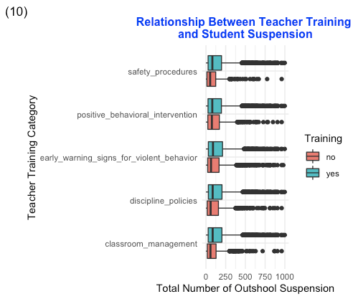

Slide 23
Next R Hurdle to Address
Jim
Touching up plots and graphics to be easier to read and comprehend
Strengthen skills using dplyr and data tidy functions
Claire
Familiarize myself with packages and their functions
Tidying data is still a major problem
Prepare for next term
How to use R in data analysis

